Slide 1



PJVelasco Data 3 Apocolypse Food Prep - DAX
View in Power BI
Last data refresh:
17/04/2025 4:28:05 pm UTC
Downloaded at:
18/04/2025 12:21:03 am UTC

Slide 2
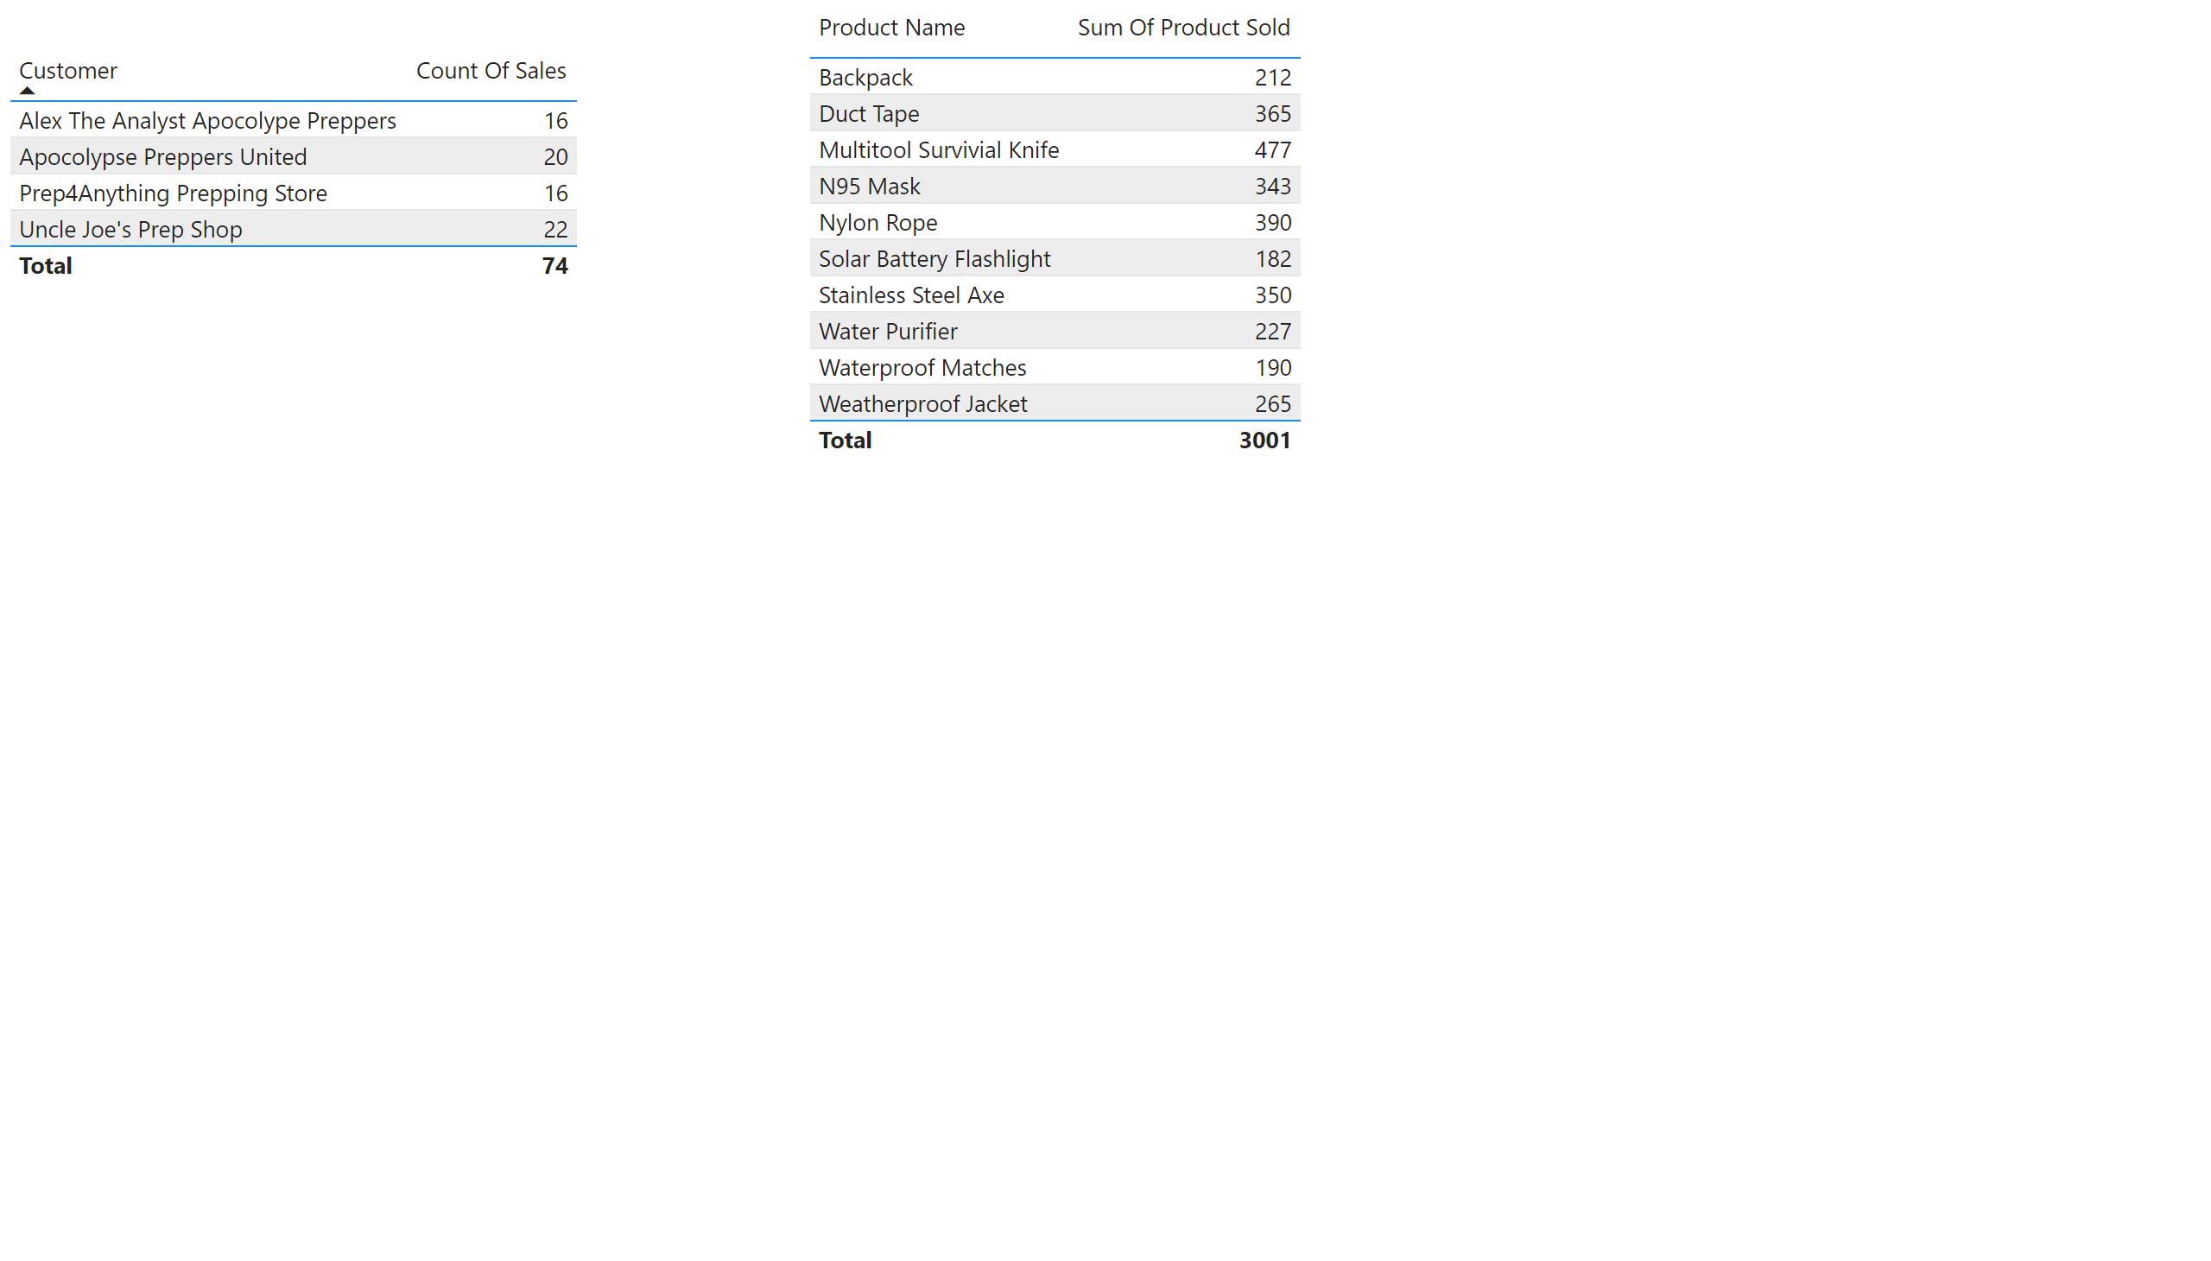
Page 1
Notes:
tableEx
No alt text provided
tableEx
No alt text provided

